Slide 1
Operators, expressions and statements in Python

Slide 2
Operators are special symbols which represents computation. They are applied on operand(s), which can be values or variables. Same operator can behave differently on different data types. Operators when applied on operands form an expression. Operators are categorized as Arithmetic, Relational, Logical and Assignment. Value and variables when used with operator are known as operands.

Slide 3
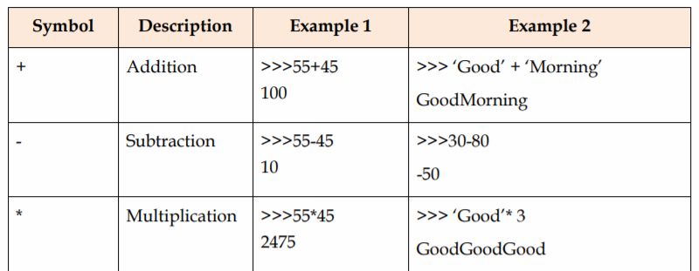
List of operators
Mathematical/Arithmetic Operators
/ | Division | >>> 18/3 6.0 | >>> 9/2 4.5

Slide 4
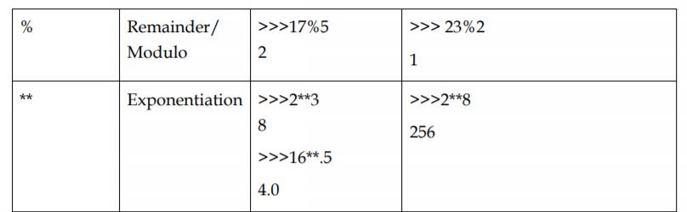
// | Integer Division | >>> 18//3 6 | >>> 9//2 4

Slide 5
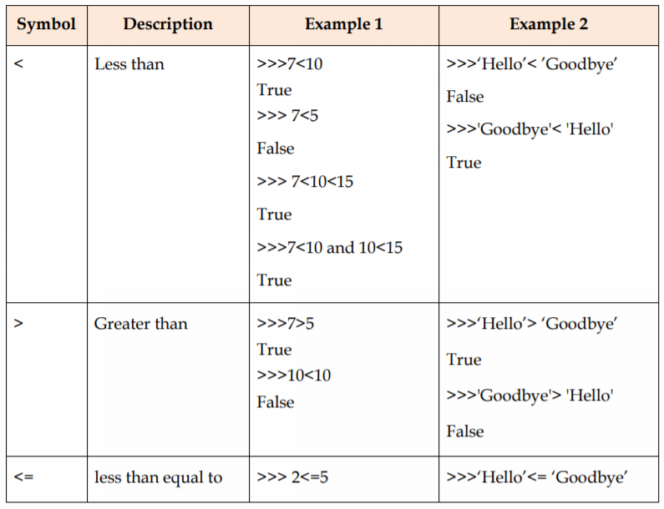
Relational Operators

Slide 6
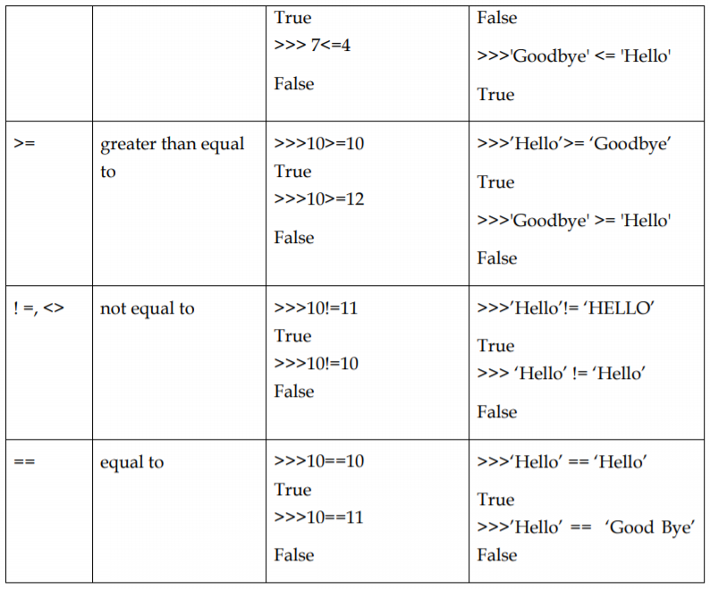

Slide 7
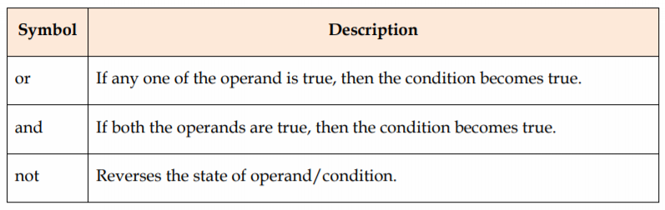
Logical Operators

Slide 8
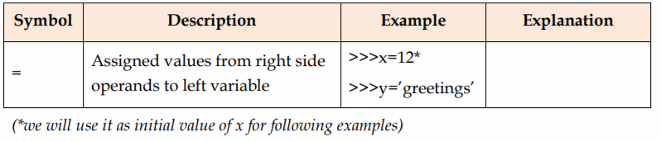
Assignment Operators

Slide 9
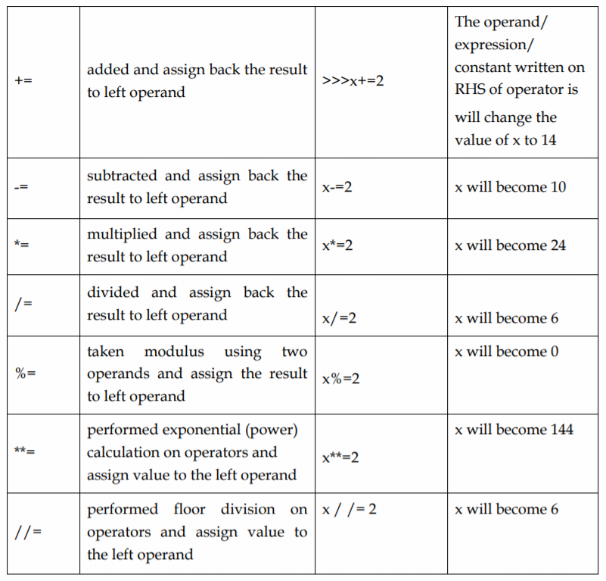

Slide 10
Note:
Same operator may perform a different function depending on the data type of the value to which it is applied.
Division operator “/” behaves differently on integer and float values.

Slide 11
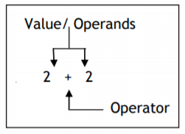
Expression and Statements
An expression is a combination of value(s) (i.e. constant), variable and operators. It generates a single value, which by itself is an expression.
Example:
The expression is solved by Computer and gets it value. In the above example, it will be 4, and we say the expression is evaluated.
Note: Expression values in turn can act as, Operands for Operators

Slide 12
10+5 and 9+4+2 are two expressions which will result into value 15. Taking another example, 5.0/4+ (6- 3.0) is an expression in which values of different data types are used. These type of expressions are also known as mixed type expressions.
When mixed type expressions are evaluated, Python promotes the result of lower data type to higher data type, i.e. to float in the above example. This is known as implicit type casting. So the result of above expression will be 4.25.
Expression can also contain another expression.

Slide 13
Operator Precedence
When we have an expression consisting of sub expression(s), how does Python decide the order of operations?
It is done based on precedence of operator. Higher precedence operator is worked on before lower precedence operator. Operator associativity determines the order of evaluation when they are of same precedence, and are not grouped by parenthesis. An operator may be Left-associative or Right –associative. In left associative, the operator falling on left side will be evaluated first, while in right assosiative operator falling on right will be evaluated first.
Note: In python „=‟ and „**‟ are Right Associative.

Slide 14
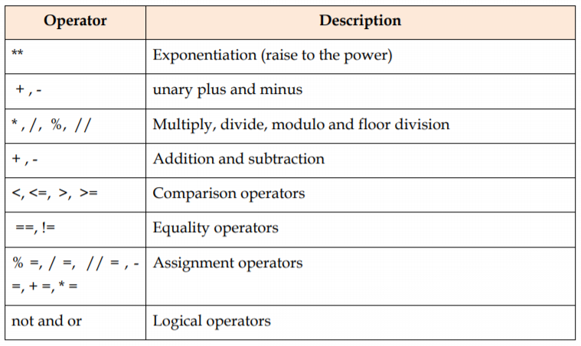
Precedence of operator from high precedence to low precedence

Slide 15
Using the above table, we know that 9+4 itself is an expression which evaluates to 13 and then 13+2 is evaluated to 15 by computer. Similarly, 5.0/4 + (6-3.0) will be evaluated as 5.0/4+3.0 and then to 1.25 + 3.0, and then 4.25.
If we just type 10+, we will get an error message. This happens because 10+ is not a complete expression. A complete expression will always have appropriate number of value (Operands) with each operator. “+” needs two operands and we have given just one.
Note: Remember precedence of operators is applied to find out which sub expression should be evaluated first.

Slide 16
Expression can be combined together to form large expressions but no matter how big the expression is, it always evaluate into a single value.
A Python statement is a unit of code that the Python interpreter can execute
Example of statement are:
>>> x=5
>>> area=x**2 #assignment statement
>>>print (x) #print statement
5
>>>print (area)
25
>>> print (x, area)
5 25

Slide 17
All the statements we saw till now were simple statement, i.e. they do not contain a nested block. In Python, there are compound/ group statements also. They are sometimes called nested block. Statement belonging to a block are indented (usually by 4 spaces). Leading whitespace at the beginning of logical line is used to determine the indentation level of line. That means statement(s) which go together must have same indentation level.

Slide 18
Keep the following points in mind while writing python statements
Write one python statement per line (Physical Line). Although it is possible to write two statements in a line separated by semicolon.
Comment starts with “#” outside a quoted string and ends at the end of a line. Comments are not part of statement. They may occur on the line by themselves or at the end of the statement. They are not executed by interpreter.
For a long statement, spanning multiple physical lines, we can use “/” at the end of physical line to logically join it with next physical line. Use of the “/” for joining lines is not required with expression consists of ( ), [ ], { }
When entering statement(s) in interactive mode, an extra blank line is treated as the end of the indented block.
Indentation is used to represent the embedded statement(s) in a compound/ Grouped statement. All statement(s) of a compound statement must be indented by a consistent no. of spaces (usually 4)
White space in the beginning of line is part of indentation, elsewhere it is not significant.

Slide 19
Note:
Wrong indentation can give rise to syntax error(s).
Most Python editor will automatically indent the statements.
A physical line is what you see as a line when you write a program and a logical line is what Python sees as a single statement.

